Slide 1


Department of Computer Science and Engineering
Team Balance:
Group Project Contribution Tracker
NAME : Mithran VT
REG NO:240701312
MENTOR:DR J JINU SOPHIA

Slide 2
ABSTRACT
TeamBalance is a low-code application designed to improve the management of college group projects.
It helps teams assign tasks, track completion, and maintain individual contribution records.
The application provides project progress reports and dashboards for monitoring team performance.
Peer feedback helps team members evaluate collaboration and workload distribution.
AI-based sentiment analysis can help summarize feedback and identify potential collaboration issues.
The system aims to improve transparency, accountability, and fairness in teamwork.

Slide 3
PROBLEM STATEMENT
Unequal distribution of work among group members.
Difficulty tracking task completion and project deadlines.
Lack of proper documentation of individual contributions.
Limited visibility into team progress and delayed assignments.
Challenges in collecting and analyzing peer feedback.
Problem statement: To develop a centralized low-code application that tracks group project tasks, individual contributions, progress, and peer feedback to improve accountability and workload fairness.

Slide 4
PROPOSED WORK
Develop the application using Zoho Creator.
Create forms for project details, team members, task management, contribution logs, and project approvals.
Implement automated task status updates and progress tracking.
Provide role-based access for administrators, team leaders, and team members.
Create a TeamBalance Dashboard to display project progress, pending tasks, and contribution summaries.
Integrate peer feedback and planned AI sentiment analysis.
Use reports and workflows to support project monitoring and decision-making.

Slide 5
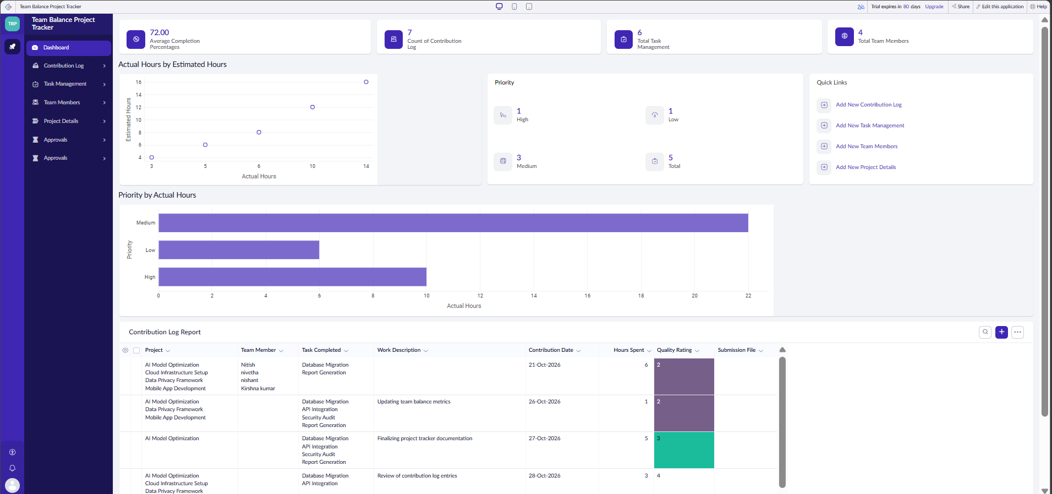
SYSTEM MODULES – DASHBOARD MODULE
Average Completion Percentage: Displays the overall completion metric.
Contribution Log Count: Shows the number of recorded contributions.
Total Task Management: Displays the task management record count.
Team Members: Shows the total number of team members.
Work Hours Analysis: Compares actual hours with estimated hours using a chart.
Priority Analysis: Displays task priorities such as High, Medium, and Low.
Contribution Log Report: Provides details of projects, team members, completed tasks, work descriptions, contribution dates, hours spent, and quality ratings.

Slide 6
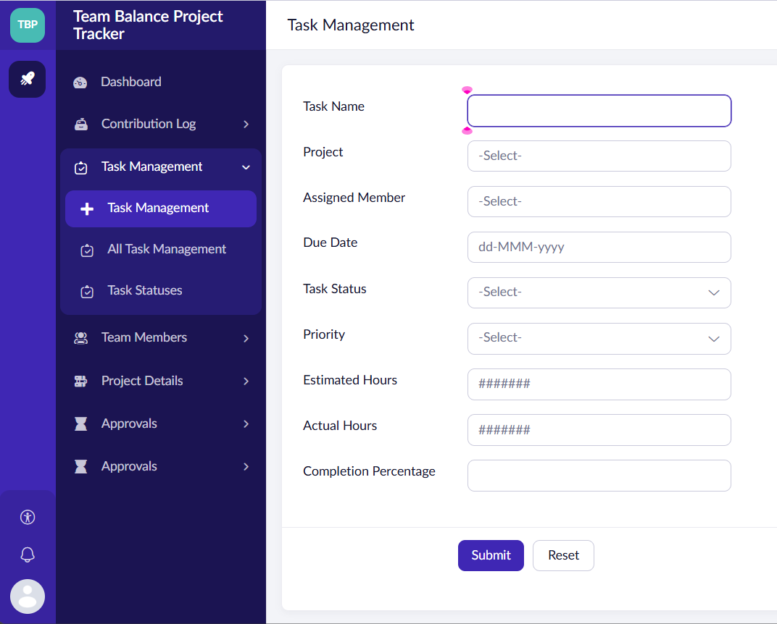
SAMPLE FORM— FORMS MODULE
Task Name: Enter the name or title of the task.
Project Selection: Associate the task with a specific project.
Assigned Member: Assign the task to a team member.
Due Date: Set the deadline for task completion.
Task Status: Track the current status of the task.
Priority: Classify tasks as High, Medium, or Low.
Estimated and Actual Hours: Record the expected time and the time spent completing the task.
Completion Percentage: Track the progress of the task.
Submit and Reset Options: Save task details or clear the form entries.

Slide 7
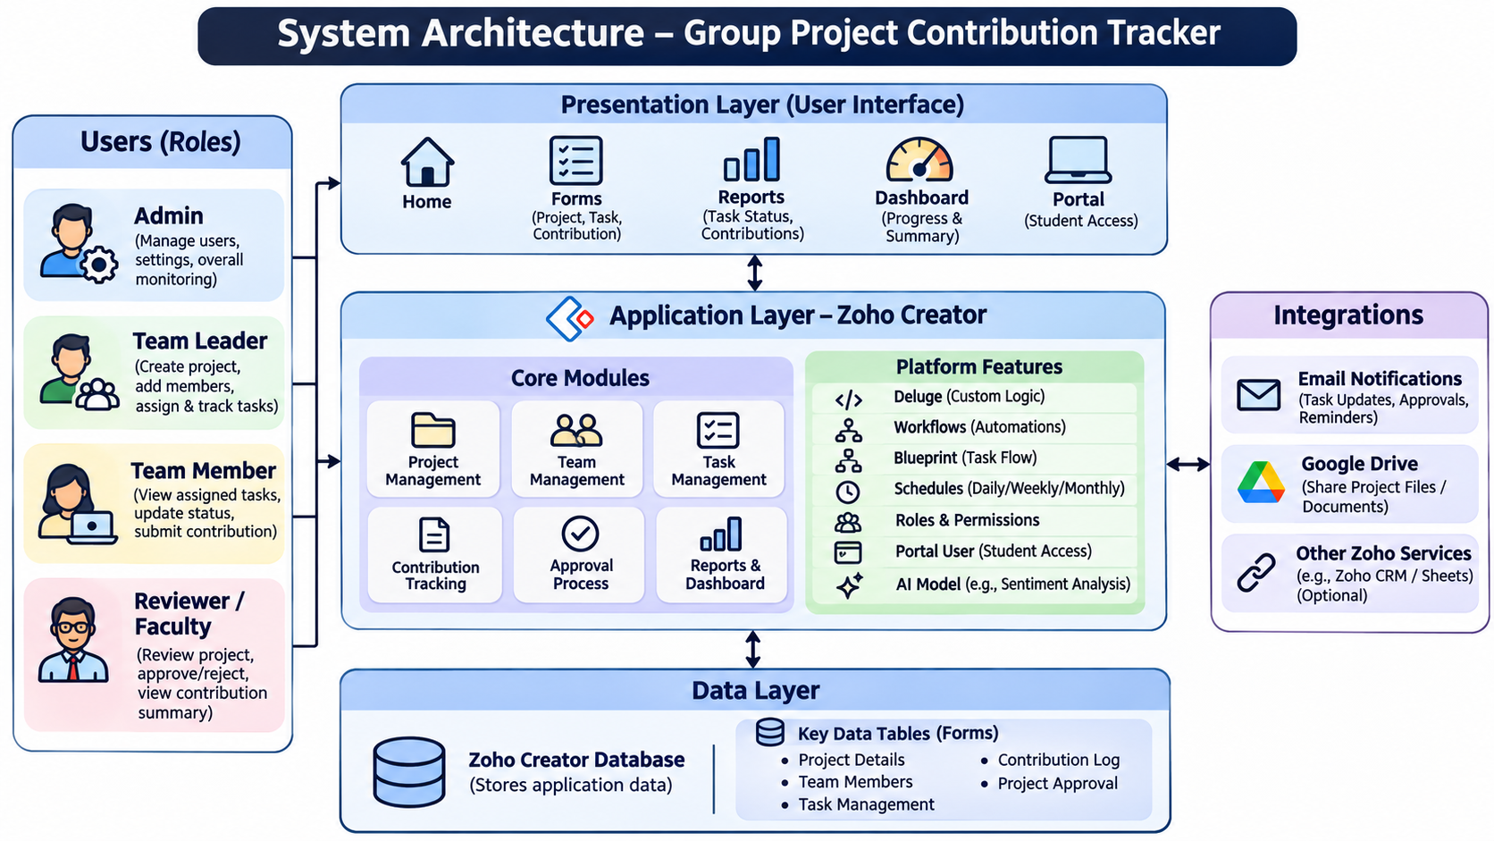
ARCHITECTURE DIAGRAM

Slide 8
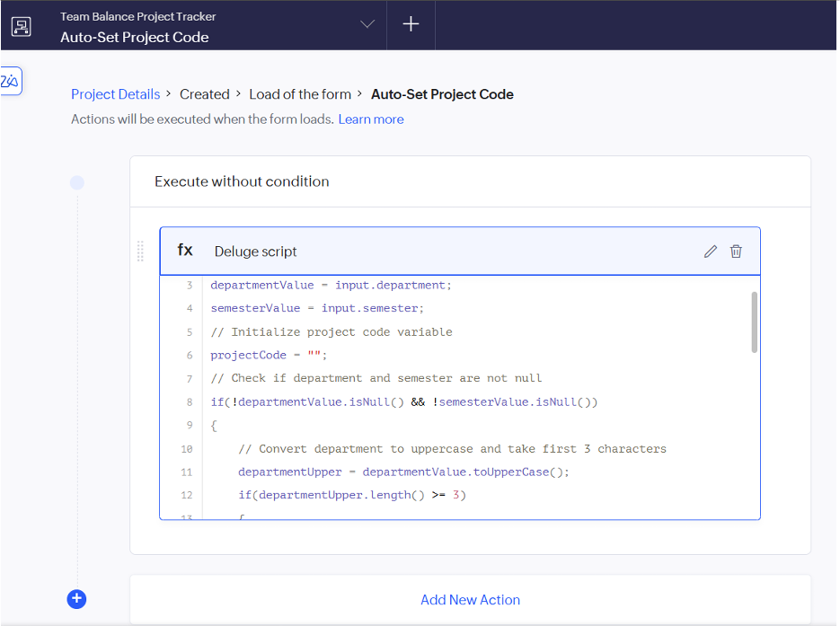
SAMPLE SCRIPT-SAMPLE DELUGE WORK SCRIPT
Form Load Automation: Executes the script when the Project Details form loads.
Department Identification: Converts the department name to uppercase and extracts its first three characters.
Semester-Based Coding: Uses the selected semester as part of the project code.
Input Validation: Checks whether the department and semester fields contain values before generating the code.
Automatic Code Assignment: Creates a consistent project identifier, reducing the need for manual entry.
Benefits:
Reduces manual data entry and human errors.
Maintains a consistent project identification format.
Makes project records easier to identify and organize.
Demonstrates workflow automation using low-code development.

Slide 9
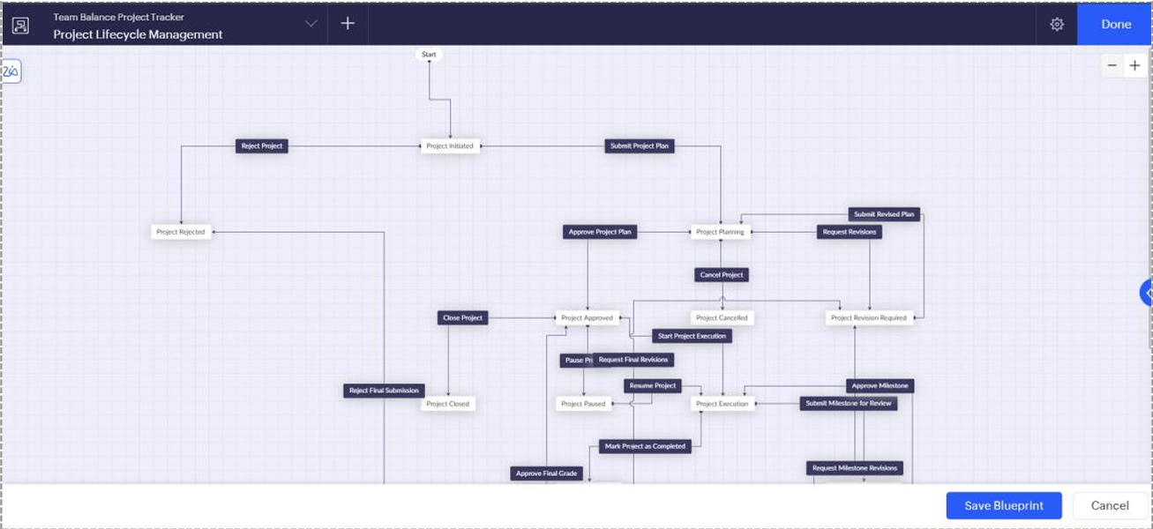
DEMO BLUEPRINT–BLUPRINT WORKING&ANALYSIS
Project Initiation: Starts the project creation and planning process.
Project Plan Submission: Allows the project plan to be submitted for review.
Approval and Revisions: Enables authorized users to approve project plans or request revisions.
Project Execution: Moves approved projects into the execution stage.
Milestone Management: Supports milestone submission, review, approval, and revision.
Pause and Resume: Allows projects to be paused and resumed when necessary.
Cancellation and Rejection: Handles cancelled projects, rejected submissions, and rejected project plans.
Project Closure: Manages the final completion and closure of projects.

Slide 10
CONCLUSION
TeamBalance – Group Project Contribution Tracker was developed using Zoho Creator, a low-code application development platform.
The application simplifies project management through task allocation, contribution tracking, and team member management.
The dashboard provides a centralized view of project progress, task priorities, working hours, and contribution records.
Deluge scripting automates project code generation, while Blueprint workflows manage project approvals, revisions, execution, and closure.
The system promotes transparency, accountability, and better coordination among team members.
Future enhancements can include advanced AI-based feedback analysis, automated notifications, and improved workload imbalance detection.

Slide 11
FUTURE WORK
AI-Based Feedback Analysis: Integrate sentiment analysis to evaluate peer feedback and identify collaboration issues.
Workload Imbalance Detection: Develop automated mechanisms to identify uneven task distribution among team members.
Automated Notifications: Send reminders for upcoming deadlines, overdue tasks, and pending approvals.
Advanced Analytics Dashboard: Introduce detailed reports on individual contributions, task completion rates, and team performance.
External Tool Integration: Connect with collaboration and project management tools to improve coordination.
Enhanced Approval Workflow: Improve project and milestone approval processes through additional automated rules.
Mobile Accessibility: Enhance the application for convenient access through mobile devices.

Slide 12
REFERENCES
1. Zoho Creator Documentation. Official guide to low-code application development, forms, reports, and dashboards.
https://www.zoho.com/creator/help/
2. Zoho Deluge Documentation. Reference for scripting, data manipulation, and application automation.
https://www.zoho.com/deluge/help/
3. Zoho Creator Workflow Documentation. Guide to workflow rules, automated actions, and form events.
https://www.zoho.com/creator/help/workflows/
4. Zoho Creator Blueprint Documentation. Reference for designing project lifecycle workflows, approval processes, and status transitions.
https://www.zoho.com/creator/help/blueprint/
5. Zoho Creator Reports Documentation. Guide to creating reports, charts, and dashboards for project monitoring.
https://www.zoho.com/creator/help/reports/
6. Zoho Creator Forms Documentation. Reference for designing data-entry forms and managing application records.
https://www.zoho.com/creator/help/forms/
7. Zoho Corporation. Zoho Creator — Low-Code Application Development Platform.
https://www.zoho.com/creator/

